Slide 1
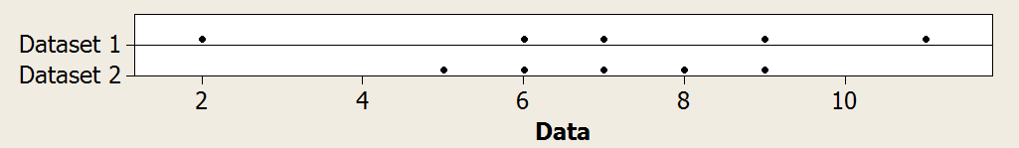
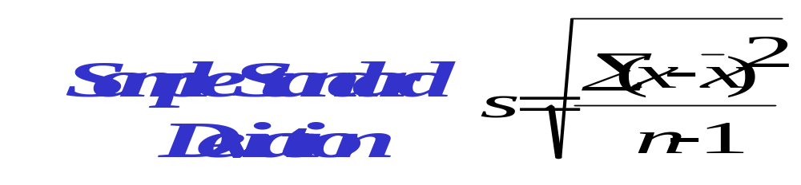
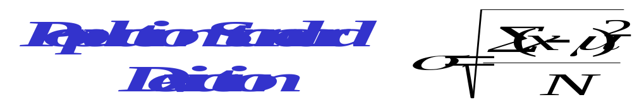
Measures of Variation Standard Deviation
Standard Deviation is a measure of variation within a dataset. It measures the amount of variation around the mean.

Slide 2
Standard Deviation
Dataset 1 2 6 7 9 11
s = 3.39
Dataset 2 5 6 7 8 9
s = 1.58

Slide 3
The Normal Distribution
Many natural phenomena are normally distributed, such as:
the heights of all people in the world, country.
- the life of an energizer battery.
- the weights of cereal in each box of frosted flakes.
- biological phenomena
Notes:
Think of this as a frequency distribution with many bars.
Give a few graphical examples.

Slide 4
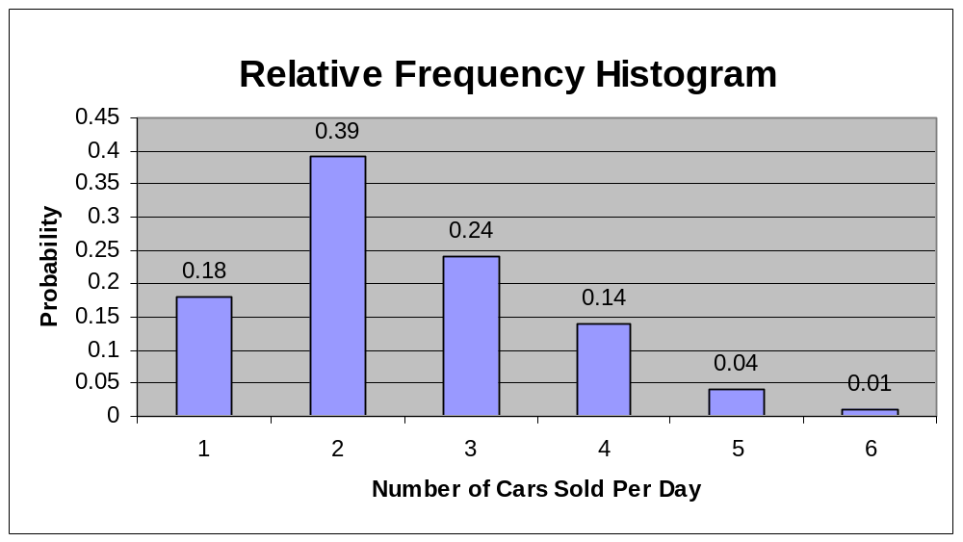
The sum of the probabilities for all possible outcomes equals 100%.
0 1 2 3 4 5

Slide 5
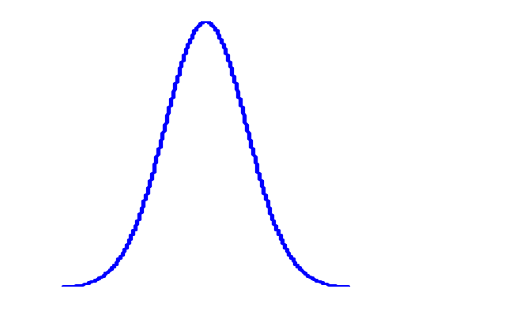

Means and Standard Deviations
Curves with different means, same standard deviation
X
10
11
12
13
14
15
16
17
18
19
20
Curves with different means different standard deviations
X
9
10
11
12
13
14
15
16
17
18
19
20
21
22

Slide 6
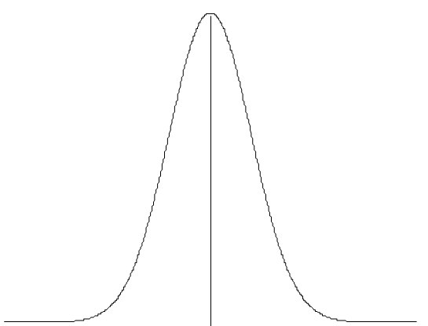
r
a
l
i
t
r
b
u
i
o
n
:
μ
=
0
,
σ²
=
1
Characteristics of a Normal Distribution
The total area under the curve equals 100%.
0
.
4
Normal
curve is
symmetrical
0
.
3
0
.
2
Theoretically,
curve
extends to
infinity
x
(
f
0
.
1
.
0
-
a
5
Mean, Median, and
Mode are equal.
50th Percentile
x
The area under the curve equals 100%.

Slide 7
Empirical Rule (68-95-99.7%)
Data with symmetric bell-shaped distribution has the following characteristics.
P.148
13.5%
13.5%
68%
Z (The Standard Normal Distribution)
4
3
2
1
0
1
2
3
4
About 68% of the data lies within 1 standard deviation of the mean
About 95% of the data lies within 2 standard deviations of the mean
About 99.7% of the data lies within 3 standard deviations of the mean
Notes:
This type of distribution will be studied in much more detail in later chapters.

Slide 8
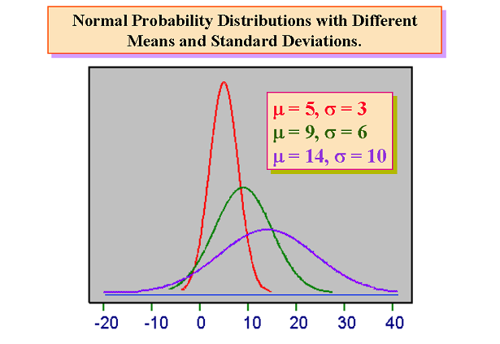

Slide 9
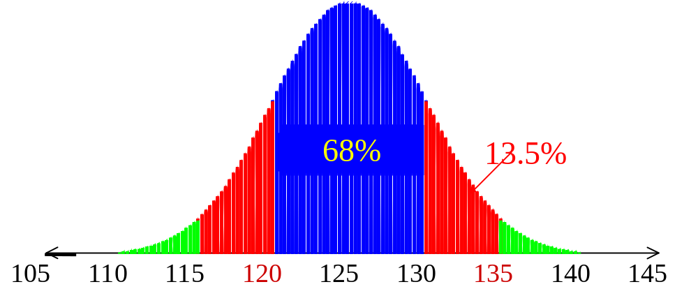
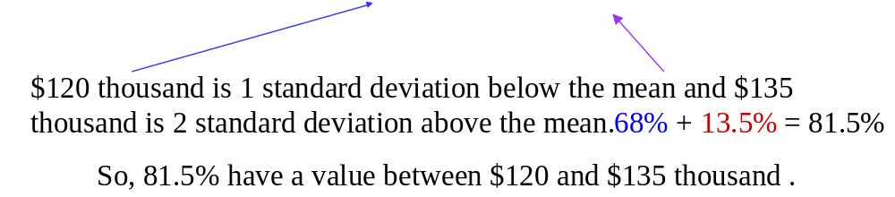
The mean value of condos on a street is $125 thousand with a standard deviation of $5 thousand. The data set has a bell shaped distribution. Estimate the percent of condos between $120 and $135 thousand:

Slide 10
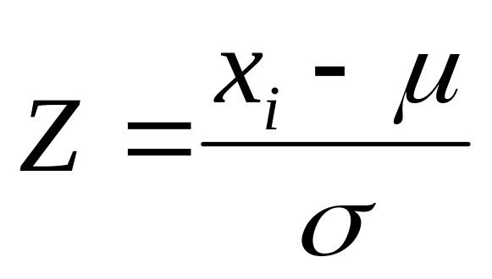
Z Score
Z Score (Standard Score; Standardized Score).
The normalized value of standard deviations that a given value x falls from the mean.
The Z score tells us how many standard deviations any given data point is away from the mean on the Standard Normal Curve.
Notes:
Draw this example graphically.
EXAMPLES:
We need to normalize because:
It’s king of like normalizing when you convert to percentiles, like when an exam where you get 19/25 (76%), and then another exam where you get 78/90 (87%).
Contrast a 5 year old girl’s height with that of her peers (classmates). How far from the norm is she for her age? Then contrast her mothers height with her peers (other adults). How far from the norm is she?
Contrast an 8 year old boy’s IQ test with that of a 35 year old math PhD.

Slide 11
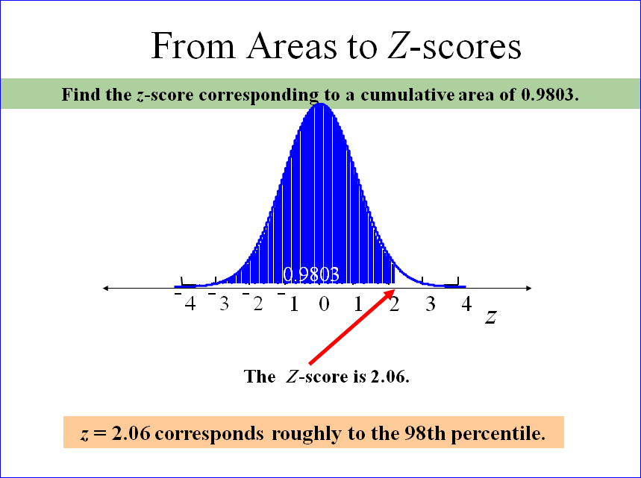

Slide 12
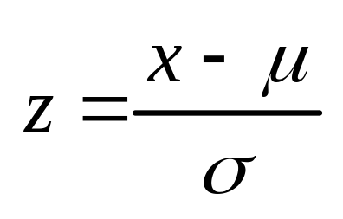
Z Score
Z Score (Standard Score). The normalized number of standard deviations that a given value x falls from the mean.
Example. Suppose a student gets a 73 out of 100 (73%) on a statistics test, and a 26 out of 30 (87%) on a biology test. Which test score is higher?
Hint:
the mean and standard deviation for the statistics test was 63 and 7.0, respectively.
the mean and standard deviation for the biology test was 23 and 3.9, respectively.
Notes:
Draw this example graphically.
EXAMPLES:
We need to normalize because:
It’s king of like normalizing when you convert to percentiles, like when an exam where you get 19/25 (76%), and then another exam where you get 78/90 (87%).
Contrast a 5 year old girl’s height with that of her peers (classmates). How far from the norm is she for her age? Then contrast her mothers height with her peers (other adults). How far from the norm is she?
Contrast an 8 year old boy’s IQ test with that of a 35 year old math PhD.

Slide 13
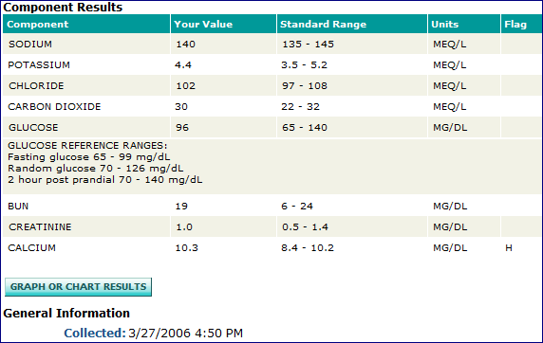
This is a 2σ range: µ=9.3;σ=.45 3σ ➔ 7.95 – 10.65

Slide 14
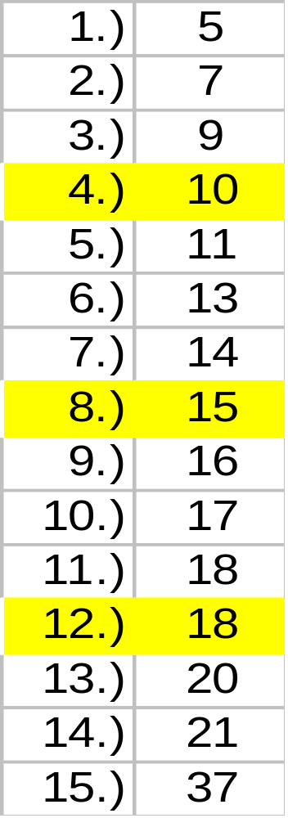
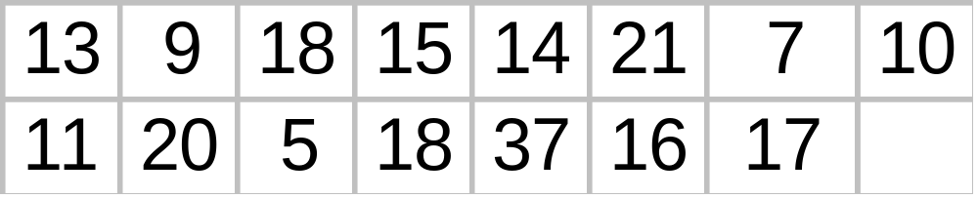
Quartiles & Percentiles
The quartiles divide ordered data into four equal parts. One-fourth of the data falls on or below the first quartile, while one-half falls on or below the second quartile (median).
Notes:
See p. 88.

Slide 15
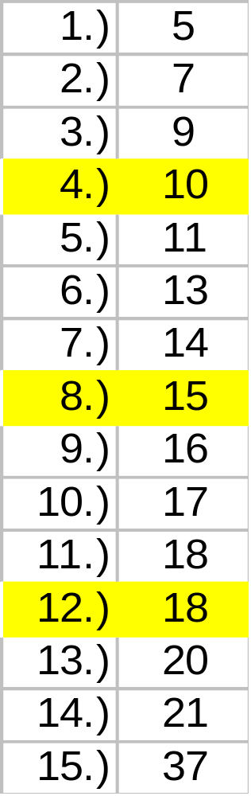
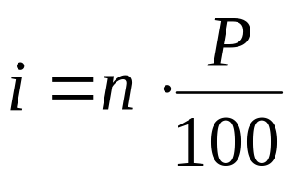
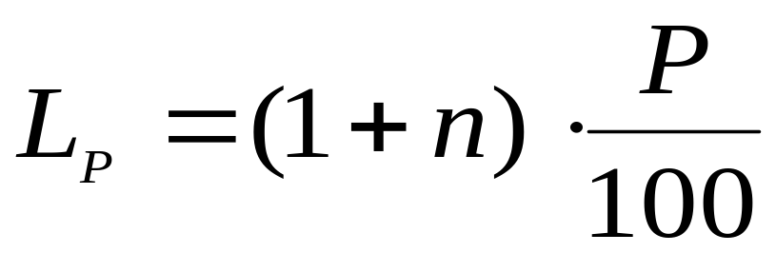
Location of Percentiles
See P. 128 & 129
Notes:
See p. 88.

Slide 16
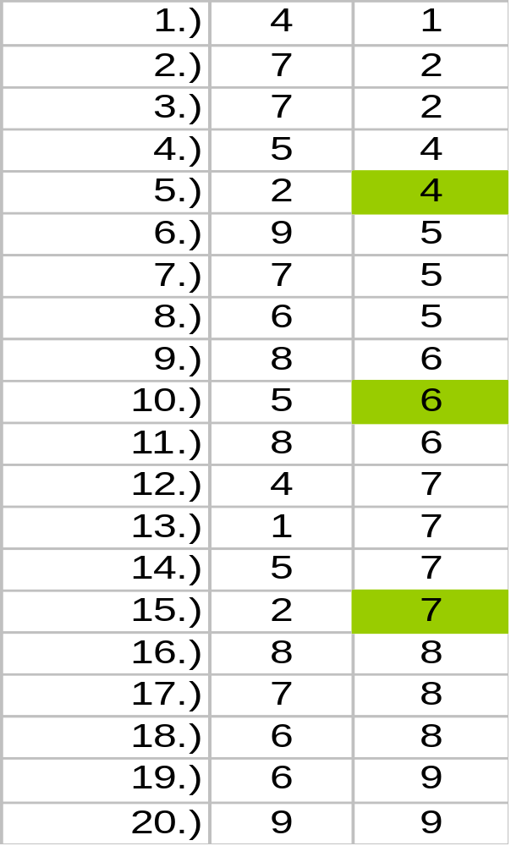
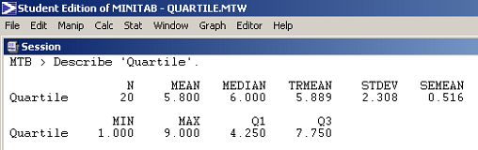
Quartile Calculations (approximations)
Excel Quartile Function
=QUARTILE(D1:D20,1) = 4.75
=QUARTILE(D1:D20,2) = 6
=QUARTILE(D1:D20,3) = 7.25
TI-83/84
Q1 = 4.5
Q2 = 4.6
Q3 = 7.5
Notes:
There is some difference of opinion on what the is exactly the first and third quartiles of data. The definition of “About one quarter of the data falls on or below the first quartile Q1” is somewhat ambiguous since there is no mathematical formula involved. See definition on P.87.
From this example we can visually see that Q1 = 4, while Minitab shows Q1 = 4.25, and the book shows Q1 = 4.5, while Excel shows Q1 = 4.75 !!.
However, there is never any controversy on what Q2 is since it is always the median, which is always mathematically defined.

Slide 17
Interquartile Range
The interquartile range (IQR) is the difference between the first and third quartiles.
IQR = Q3 - Q1
= 18 - 10
= 8
Notes:
See p. 88.

Slide 18
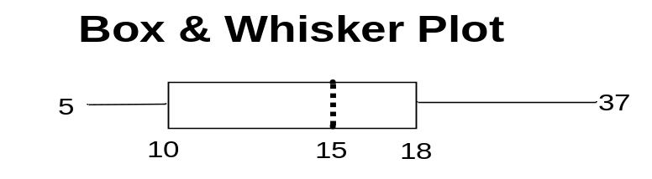
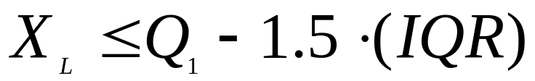
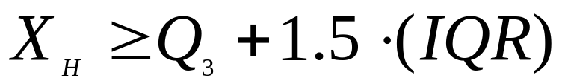
Outliers
When a dataset contains one or more data points that are far removed from the rest of the data, these extreme values are referred to as outliers.
Outliers are often the result of data entry errors. These unusual readings should be explored further before applying any other statistical methods (computations).
IQR = Q3 - Q1
= 18 - 10
= 8
Notes:
See p. 88.

Slide 19
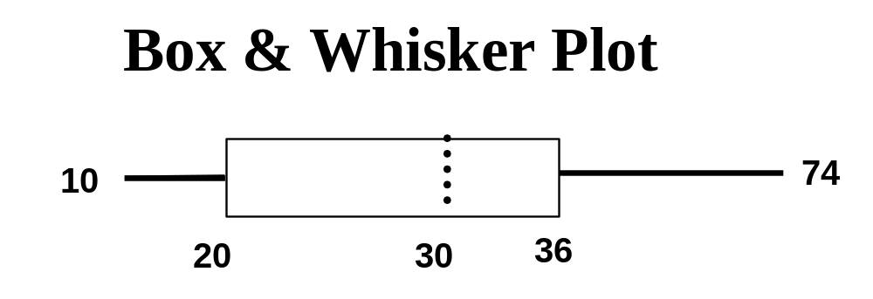
Outliers
When a dataset contains one or more data points that are far removed from the rest of the data, these extreme values are referred to as outliers.
Outliers are often the result of data entry errors. These unusual readings should be explored further before applying any other statistical methods (computations).

Slide 20
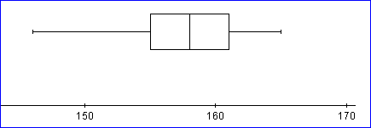
For this dataset, what is the low value, the high value, the median, and the first and third quartiles. Are there any outliers?

